Slide 1

1.3.3 Lecture slides with audio
Grand growth narrative
Inequality & humanity
What has gone badly wrong
<https://github.com/braddelong/public-files/blob/master/econ-115-module-1-lecture-3.3-going-wrong-%23tceh.pptx>
Slouching towards utopia?
Link
Link

Slide 2
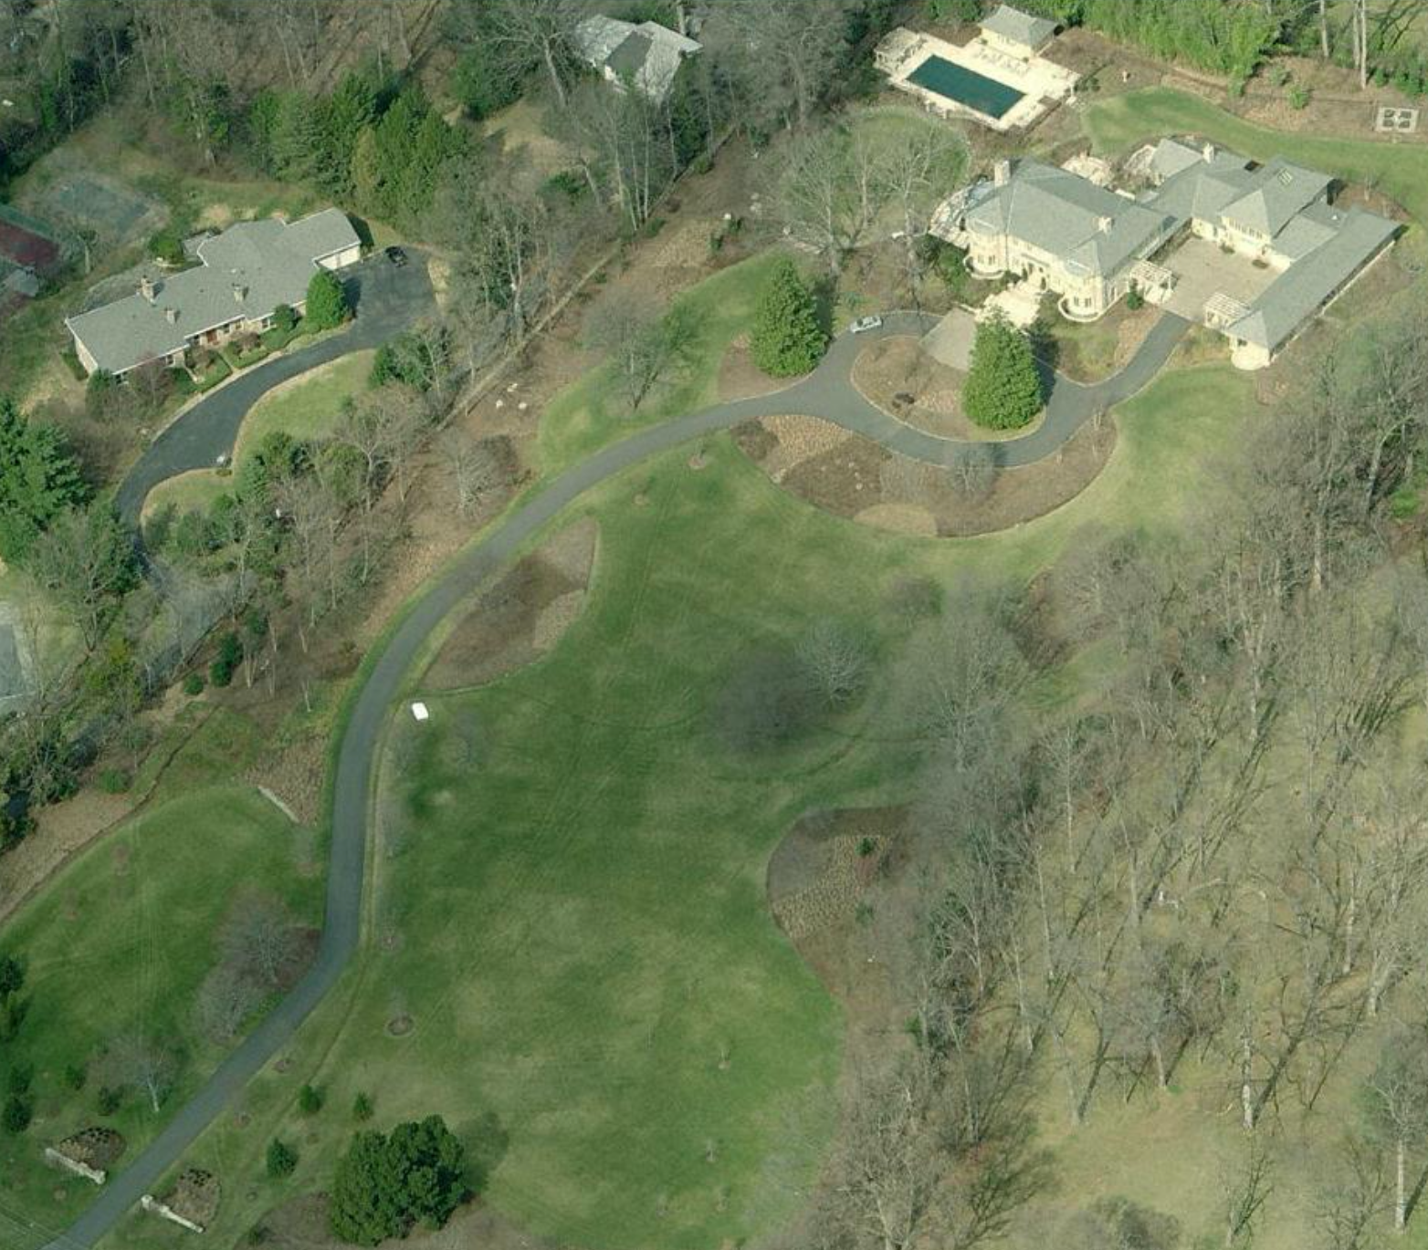

Lecture: 1.3.3. What Has Gone Badly Wrong
Tyrannies, wealth gulfs, mismanagement:
Hitler, Stalin, Mao—and their little brothers. Enough said…
Well, maybe not enough said: the peculiar thing was that (most of?) these tyrannies were powered by ideas about economic organization
Wealth gulfs of a magnitude previously unbelievable
Pre-1870 societies simply were not rich enough formodern second gilded age degrees of wealth inequality to be possible
Failures of management
Mass unemployment
Karl Polanyi’s insights:
The market economy recognizes only property rights
But people think they have rights to land, labor, and finance
Land: a stable community, and an absence of negative externalities
Labor: a right to a stable income commensurate with what one deserves (and to appropriate income and status differentials: unequals should be treated unequally)
Finance: that the stability of one’s job and one’s business not depend on incomprehensible decisions of financiers thousands of miles away
The Friedmans bought a seven-and-a-half-acre lot in Bethesda, Maryland. They tore down the existing house, built an eleven-thousand-square-foot replacement, and planted two hundred trees. (In a note at the end of “Hot, Flat, and Crowded,” where Friedman explains his own ecological circumstances—geothermal heating, solar panels—he invites readers, perhaps unwisely, to regard his real-estate move as an act of rescue: he writes that he and his wife bought the land “to prevent it from being redeveloped into a subdivision of a dozen or more houses,” which could sound like someone buying a lot of champagne to protect society from corkrelated injuries.)… “Honestly, I still can’t wait to get my pants on in the morning,” Friedman said…. On weekdays, he’ll head into D.C. for a seven-thirty breakfast meeting…
2:30 of audio in this slide; 15:30 in this slide group
Notes:
The story of increasing wealth, productivity, and technology in the long 20th century is a very hopeful one. The story of demography, gender roles, ethno-linguistic fractionalization in the 20th century is also for the most part a hopeful one. It is likely that people are less substantially and explicitly hemmed-in and dominated on account of what is in their genes – or what some people think is in their genes–now at the end of the 20th century then has ever been the case before.
But the story of our third set of themes is not hopeful and not positive. The 20th century has seen the worst, most destructive, most brutal, and most genocidal tyrannies in world history. The 20th century has also seen the growth of enormous wealth gaps. The most important of these are the extraordinary wealth gulfs between the countries of the global north and those of the poor parts of the global south. But there are also enormous wealth gulfs within countries. And these wealth gulfs carry with them great divergences in social power among members of a single national society.
Off to the right is a picture of the 11,000 square-foot mansion of New York Times columnist Thomas Friedman on its 7.5 acre lot. What does Thomas Friedman and his wife do with 11,000 ft²? OK. I have 4600 ft². But of that 1200 is basement and 600 is attic that are used for storage, and there are four of us—700 ft² per person seems like an awful lot to me.
Friedman sells it as an environmentalist move: he writes that he and his wife have geothermal heating and solar panels, and bought the land “to prevent it from being redeveloped into a subdivision of a dozen or more houses,” say 15, each of which would have cost $1 million and housed a suburban family of four or five. It was, I think, the _New Yorker_ that cracked that this was like “buying a lot of champagne to protect society from cork-related injuries”.
And in addition to tyrannies and wealth gulfs there are the facts of economic mismanagement in the twentieth century: governments are simply not good at managing economies to ensure equitable growth—or even the perception of equitable growth.

Slide 3
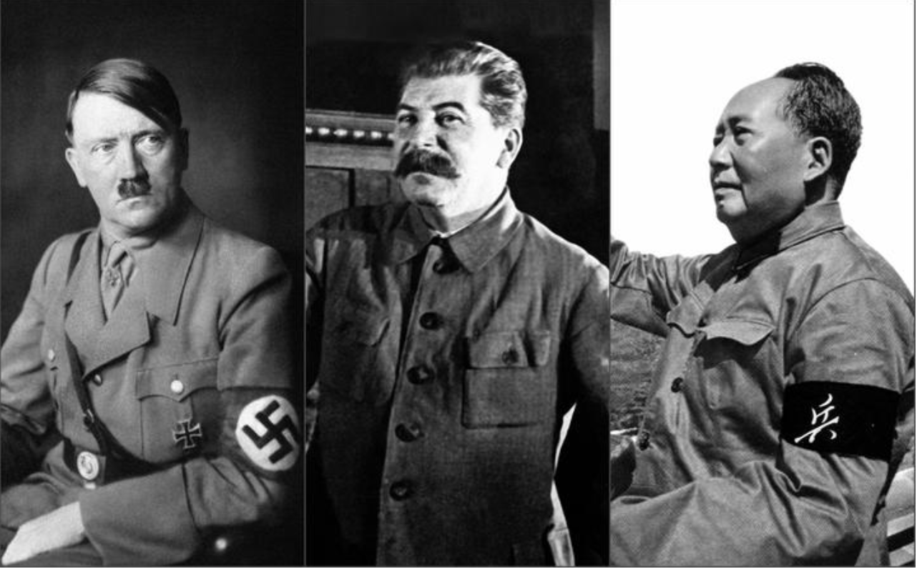
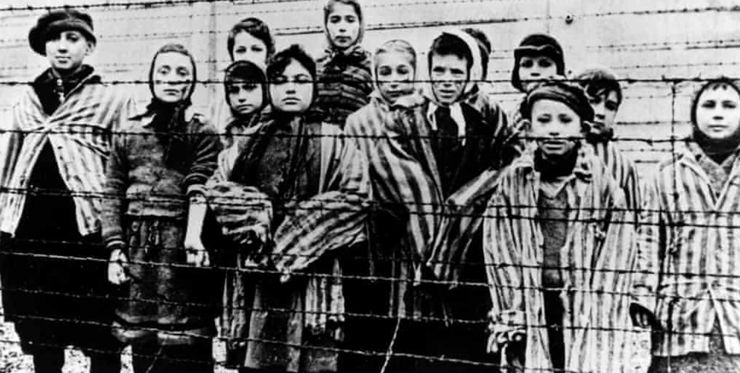
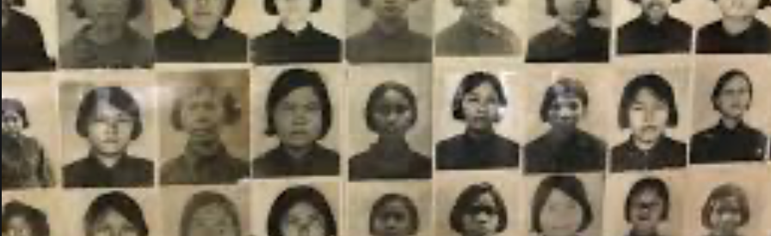
Tyrannies
Hitler, Stalin, Mao—and their little brothers:
Enough said…
Well, maybe not enough said: the peculiar thing was that (most of?) these tyrannies were powered by ideas about economic organization
4:15 audio
Notes:
Tyrannies: Hitler, Stalin, Mao—and their little brothers. Enough said…
Well, maybe not enough said: the peculiar thing was that (most of?) these tyrannies were powered by ideas about economic organization. The wars and mass murders were about how societies’ economy should be organized. And that is a strange thing to fight about.
Twentieth-Century governments and their soldiers have killed perhaps forty million people in war: either soldiers (most of them unlucky enough to have been drafted into the mass armies of the twentieth century) or civilians killed in the course of what could be called military operations. But wars have caused only about a fifth of this century’s violent death toll. Governments and their police have killed perhaps one hundred and sixty million people in time of peace: class enemies, race enemies, political enemies, economic enemies, imagined enemies.
Call those political leaders whose followers and supporters have slaughtered more than ten million of their fellow humans “members of the Ten-Million Club.” All pre-twentieth century history may (but may not) have seen two members of the Ten-Million Club: Genghis Khan, ruler of the twelfth century Mongols, launcher of bloody invasions of Central Asia and China, and founder of China's Yuan Dynasty; and Hong Xiuquan, the mid-nineteenth-century Chinese intellectual whose visions convinced him that he was Jesus Christ’s younger brother, and who launched the Taiping Rebellion that turned south-central China into a slaughterhouse for decades.
By contrast the twentieth century has seen six more join: Adolf Hitler, Chiang Kaishek, Vladimir Lenin, Joseph Stalin, Mao Zedong, and Tojo Hideki.
Hitler, Stalin, and Mao have credentials that make them charter members of the Thirty Million Club as well—and perhaps the Fifty Million Club.
A regime whose hands are as bloody as those of the 1965-1998 Suharto regime in Indonesia—with perhaps 300,000 communists, suspected communists, and others in the wrong place at the wrong time dead at its creation in 1965, and perhaps 150,000 inhabitants of East Timor dead since the Indonesian annexation in the mid-1970s, barely makes the twentieth century's top twenty list of civilian-massacring regimes.
Fear that the secret police will knock at your door and drag you off for torture and death is a serious downer. And the shooting or starvation was often part of the government’s “management” of its economy: the stick used to compel the people to perform service or labor as the government wished.
The economies of the Soviet Union in the 1930s and of China in the 1960s cannot be understood without understanding how mass terror was used as a social discipline device.
Third, and most extraordinary, the twentieth century is unique in that its wars, purges, massacres, and executions have been largely the result of economic ideologies. Before the twentieth century people slaughtered each other over theology, and people slaughtered each other over power. But only in the twentieth century have people killed each other on a large scale in disputes over the economic organization of society.
This is profoundly stupid. We all we want social mechanisms that will work in the sense of delivering prosperity, progress, and a reasonably egalitarian distribution of income. Combinations of mechanisms that fail to accomplish this should be rejected; combinations that succeed should be approved; but the key is to figure out what works and then apply it, not deduce what ought to work from first principles and then commit mass murder for it.
The last appropriate word here should be Nobel Prize-winning author Aleksandr Solzhenitsyn’s: “The imagination and inner force of Shakespeare's villains stopped short at ten or so cadavers, because they had no ideology.... It is thanks to ideology that it fell to the lot of the twentieth century to experience villainy on the scale of millions…”

Slide 4
Wealth Gulfs
Wealth gulfs of a magnitude previously unbelievable:
Pre-1870 societies simply were not rich enough for modern second gilded age degrees of wealth inequality to be possible
N generations ago each of us has 2^{N} ancestors: we are all related
What would our ancestors have wished for in terms of our wealth distribution?
Within-nation inequality dwarfed by across-nation inequality
The bottom billion, still at less than $2.50/day
4:15 audio
Notes:
Pre-1870 societies simply were not rich enough for modern second gilded age degrees of wealth inequality to be possible. Wealth gulfs mean that some people’s well-being is getting much greater weight in society’s calculations than others: it means gross inefficiency in the generation of human utility and well-being.
Every human has two parents. That means each generation we go back doubles the number of slots in each of our family trees. Go back 10 generations, 250 years, and we each have 1000 ancestral slots in that generation. 1000 years gives each of us 1 trillion slots in our ancestral family tree, which need to be filled by the 300 million people than alive on the earth, of whom about 200 million have left living descendants.
That means that the average person alive in 1000 who left living descendants fills 5000 separate slots in my and in your family tree. If we pick anyone alive in 1000, and if that person has any living descendants at all, odds are that we are all descended from them.
That is how the human family mixes over time.
Would our ancestors back then have wished for a world today in which some of their descendants are billionaires living in palaces in Atherton while others live in their cars? Probably not. They probably would have wanted to tell their rich great⁴⁰-grandchildren: you should share some.
But that is not the world we have.
When we look across nations things are even more fraught.
Those economies relatively rich at the start of the twentieth century have by and large seen their material wealth and prosperity explode. Those nations and economies that were relatively poor have grown richer, but for the most part slowly. The relative gulf between rich and poor economies has grown steadily over the past century. Today it is larger than at any time in humanity’s previous experience. The gulf across which the world’s rich and poor regard each other exists in every dimension: how much people consume, whether they can read, what tools they use, and how they make their living.
This glass can be viewed either as half empty or as half full.
It is half empty because we live today in the most unequal world ever.
It is half full because most of the world has already made the transition to sustained economic growth; most people live in economies that (while far poorer than the leading-edge postindustrial nations of the world’s economic core) have successfully climbed onto the escalator of economic growth and thus the escalator to modernity. The economic transformation of most of the world is less than a century behind that of the leading-edge economies—only an eyeblink behind, at least from the millennial perspective.
However, the millennial perspective is one that human beings can adopt only when contemplating the long-dead past—not when thinking about their present or their immediate children’s future.
On the other hand, one-tenth of humanity has not made the transition to economic growth, and has not climbed onto the escalator to modernity at all. The median inhabitant of Africa has access to modern public health and to a village cell phone. But do they have higher real incomes than did their predecessors of two generations ago? It is not obvious that the answer is “yes”.
From an economist’s point of view, the existence, persistence, and increasing size of large gaps in productivity levels and living standards seems bizarre. Hands and brains and eyes are much the same, after all. And more: it is a scandal, and a crime.

Slide 5
Mismanagement
Desired: equitable growth
Failures of management
Mass unemployment
Karl Polanyi’s insights:
The market economy recognizes only property rights
But people think they have rights to land, labor, and finance
Land: a stable community, and an absence of negative externalities
Labor: a right to a stable income commensurate with what one deserves (and to appropriate income and status differentials: unequals should be treated unequally)
Finance: that the stability of one’s job and one’s business not depend on incomprehensible decisions of financiers thousands of miles away
4:30 audio
Notes:
As we have seen since 2005, little if anything has been learned about how to regulate the un-self-regulating market in order to maintain prosperity, or ensure opportunity, or produce substantial equality.
This is a puzzle. For economic management is not rocket science.
The problems of economic policy in the modern age are, speaking very broadly, twofold: the problem of managing “fictitious commodities”, and the problem of managing “aggregate demand”.
By “fictitious commodities” Austro-Jewish historian Karl Polanyi meant this: People believe that they have rights to a stable community and to the place in it they believe they deserve, to a level of income consonant with how hard they work and who they are, and to a stable economic environment in which they can do their jobs.
The problem is that market economies recognize only property rights. And the only property rights that are worth anything are those that help you make things for which the current batch of rich people have a serious jones.
Thus in a market economy everything, everything must pass a profitability test.
Would it be more profitable to move you out of your neighborhood and move a different group of people in? The market economy will make it happen. Are your skills those that are, by mischance, currently in excess supply in the global marketplace? Your income will drop to zero. Has some rootless cosmopolite financier thousands of miles away decided that a higher rate of profit can be made by pulling the plug on the productive value chain you participate in and standing up something else hundreds or more miles away? Your job and the firm you work for will dry up and blow away.
People then call on society and the government to protect them—to vindicate their Polanyian rights, to keep the market economy from treating the land they live on, their labor applied to production, and the finance that keeps it all running as mere commodities to be shifted willy-nilly to their most profitable use as the creative destruction processes of the market economy slouch forward. And if society, polity, and government do not respond, people will find a way to make a different society, polity, and government that people are willing to promise them will vindicate their Polanyian rights, and treat the “fictitious commodities” as what they really are: the fabric of people’s lives.
By “stabilizing aggregate demand” we mean avoiding the grand mal seizures of the economic mechanism like 2008-9. The share of 25-54 year-olds—too old to be in school en masss, and too young to be retired en masse—suddenly full by five full percentage points, and still has not returned to its pre-2008 level. It is the government’s job to stop this, and to fix it when it happens.
Some of mismanagement is because twentieth century economists did not know what to prescribe: the history of economic policy reads like alchemy, not chemistry. Often proposed remedies made economic problems worse. Many times one current generation’s proposed solutions to problems turn out to lay the groundwork for the next generation’s problems. And it is not always the case that larger problems are replaced by smaller ones over time.
More important, perhaps: there are many economists who will not tell you what they know. Why did America’s professional Republican economists pledge that enactment of the late 2017 Trump-McConnell-Ryan tax cut was likely to boost investment in America by $800 billion dollars in 2018, again in 2019, and so on out to the future when they knew it was highly unlikely to do any such thing? To fuzz the issue, and allow newspapers and TV journalists to say “economists disagree”.
It may be true that those who do not remember the past are condemned to repeat it, this aphorism does not stress the fact that that means that the rest of us are condemned to repeat it with them.

Slide 6
Catch Our Breath…
Ask a couple of questions?
Make a couple of comments?
Any more readings to recommend?
<>

